Slide 1
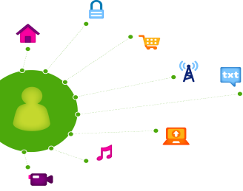
Mobilithon: Final Presentation
BraveHackers: U-verse Social
April 20-22, 2015

Slide 2
Contents
Team Name & Structure
Application Demo
Application Vision
Tools and Assets Used
Challenges/ Roadblocks & Mitigation

Slide 3
U-verse Social
Chat

Slide 4
Application Vision
U-verse Social:
Application shows the chat room of the channel currently being watched.
Person can share a link to the channel/chat room leveraging native share sheet.
Clicking on the URL will automatically launch the application.
Once launched, U-verse Social will automatically change the default set top box to the application channel.
Application Channel is a split screen of the live video and the chat room.
Person uses their hand held to interact with the chat.
People can make sub chat rooms of a channel. Rooms can be private (invite only)
Chat room moderators can take additional actions in chat. Ban People, Remove Comments, Promote Comments

Slide 5
QuickStart
Sandbox

Slide 6
Design Templates

Slide 7
Black Flag API
U-verse SDK

Slide 8

BlackFlag U-verse SDK APIs
Implemented
Get Default Set Top Box
Get Current Channel
Set Current Channel
Tested on personal set top box (Dev Channel)
Not Implemented
Show Info of Current Channel
Application Channel
Video On the Left
Chat Room on the Right

Slide 9
AngularJS
CodeCloud Sandbox

Slide 10
AngularJS Seeds and Modules
Forked angular.att.sandbox from CodeCloud
Leveraged Ionic Framework (Angular+Cordova)
AngularFirebase for Chat Backend
MobileAngularUI Components
AngularSnap
ScrollGlue

Slide 11
Cordova
Cross Platform Mobile Native Integration

Slide 12
Cordova
ShareSheet: Native sharing sheet for sharing U-verseChannel + ChatRoom Custom Links
WebIntent: Launch Native App from Custom URI
Custom Developed U-verse Plugin: In progress development of integration of U-verse Android SDK into HTML5 Client

Slide 13
ARO
Performance, Battery and Network

Slide 14
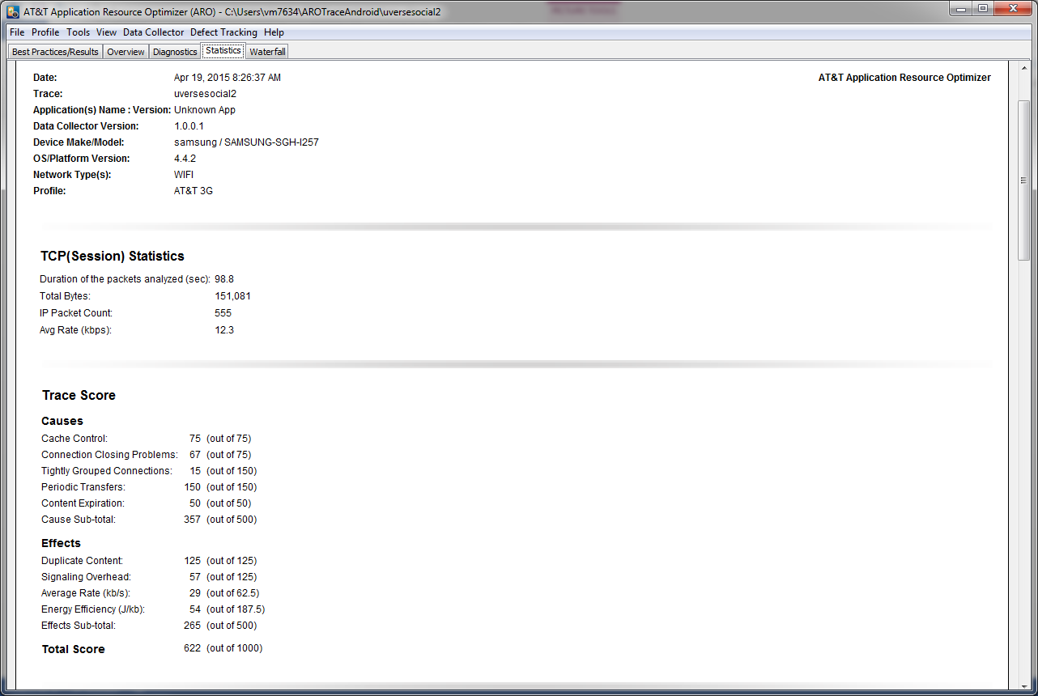
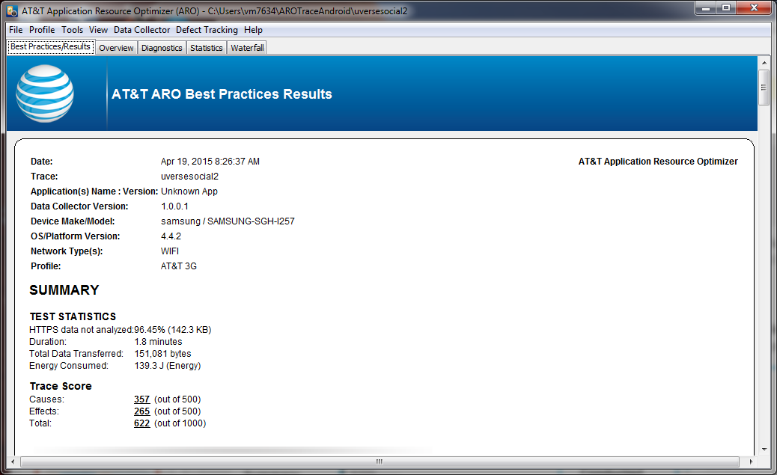
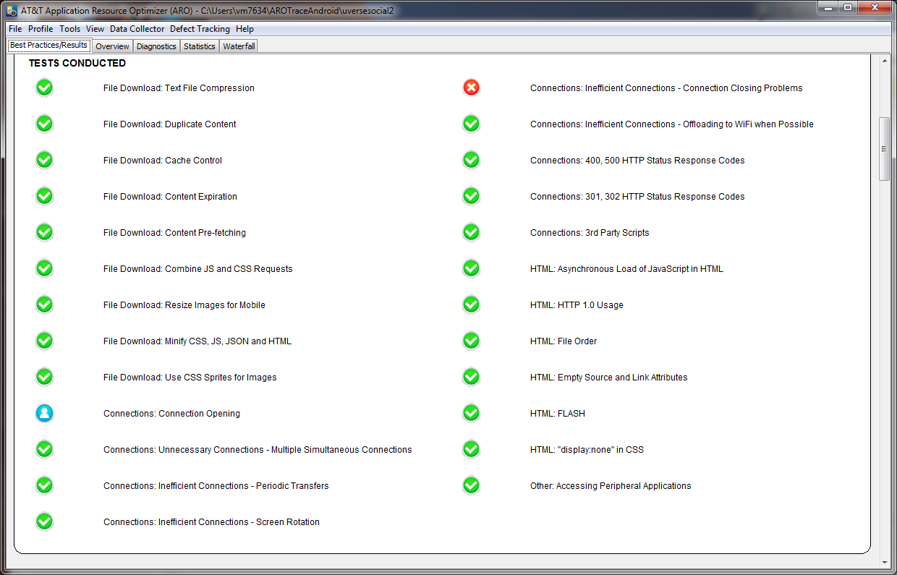
ARO
ARO tool helped our team to identify performance bottlenecks like battery power consumption, page size and page load time. I suggest, every App developer to utilize ARO tool to validate the App performance before deploying App to the App store. Our team has developed Android App using U-verse API. We were able to integrate our App with ARO tool successfully. Team has really liked Video Viewer which captured the App page flows from beginning to the end. We have attached output of ARO Video Viewer to our demo.
ARO Tool challenges
ARO tool does not support Android older version of smartphones. We have a COU phone (Samsung Galaxy S II) supports up to Android version 4.1.2 only. ARO tool did not generate tracing files from Samsung Galaxy S II. After reaching out ARO SME, we found out that ARO supports Android smart phones with version 4.4 (Kitkat) only. Team had to switch from Android version 4.1.2 to 4.4. devices. Team was able to generate trace files from a smart phone which contains Android 4.4 operating system.
Also, we found out that ARO does NOT integrate well with Android Emulator 5.0. Team had tried multiple Emulator versions and we could not able to integrate ARO with Android Emulators.

Slide 15
Perfecto Mobile
Cross Platform Cloud Testing

Slide 16
Perfecto Mobile
I found Perfecto to be a great tool for mobile development. I did not
have an Android device available for testing and while the emulator is
nice nothing beats a real device. Having a variety of devices to choose
from was helpful as well. Almost all of my time was spent using the
basic Interactive features. Our team was testing some SMS features and I
expect Automation would have been helpful to avoid slowly clicking on
the keyboard with the mouse. I never had any trouble getting the device
I wanted but if usage increases the Reservations capabilities are
excellent. My only complaint is the phone display is somewhat distorted
I would rather the default size match the real phone even though that is
quite large on a regular monitor. Overall I was very impressed with
Perfecto's ease of use and range of testing features.
Steve

Slide 17
COU Beta App Store
Distribution

Slide 18
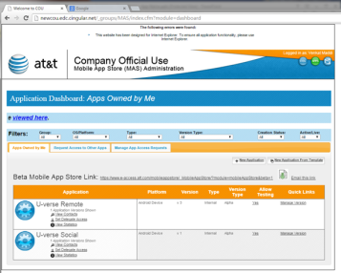
COU Beta App Store
This site is very helpful to upload mobile Apps to Beta store and make it available to COU devices. COU beta site usage and App installation instructions have been documented clearly. I was able to follow instructions and upload U-verse Social App to the COU beta site. My team’s U-verse app appeared on the COU device as soon as I logged into COU store on Android smart phone. I felt It was very easy to download the App from COU store. The Delegate and Tester capabilities allowed me to share App to my team members and Mobilithon coordinators. I really liked OTA (Over the Air) link functionality to download App directly from COU store.
Venkat

Slide 19
Design/Inspiration
Distribution

Slide 20

Inspiration Mystery Science Theater 3000
Comedic Commentators
Scripted/Improv
Overlay silhouette

Slide 21
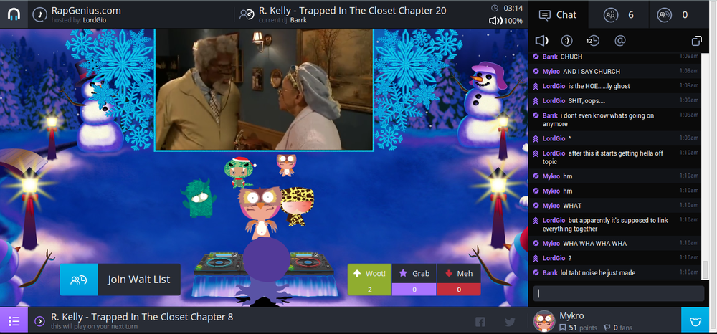
Inspiration: PlugDJ
Community
Chat
Moderated
Playful

Slide 22


Mobilithon Enablers
Living Room
Person Of Interest
On Your TV
Weo > OMG, can’t believe that just happened
Steve > Totally called it
Kelley > You have a billion theories, one was about to hit
Steve > Still called it
-- Venkat just entered the room--
Venkat > Thanks Weo for the SMS almosted missed this
Weo > NP, I knew you were sleeping ☺
Person Of Interest
Weo > OMG, can’t believe that just happened
Steve > Totally called it
Kelley > You have a billion theories, one was about to hit
Steve > Still called it
-- Venkat just entered the room--
Venkat > Thanks Weo for the SMS almosted missed this
Weo > NP, I knew you were sleeping ☺
> I love this show!!!
SHARE SETTINGS
SHARE SETTINGS
Notes:
For mailbox and tspace forum SME support – request the teams to specify the component name, e.g. “Cordova”

Slide 23

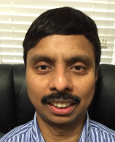

Team Name and Team Structure
Team Name : BraveHackers
Total Team Size : 5
Team Member details
MANTIONE, KELLEY L <km4657@att.com>
T.Data
Architect
UverseSDK, Cordova
Team Member details
MADDI, VENKAT <vm7634@att.com>
SD&E
Architect
Domain 2.0, Black Flag, ARO
Team Member details
BRAKKE, STEVE <sb1960@att.com>
Service Qualification
Developer
Cordova

Slide 24


Team Name and Team Structure
Cont…
Team Member details
LOPEZ, MAURICIO <ml5174@att.com>
OCE, TDICE, DLOSF
Architect
Frontend, Backend, T.Data, NetBeans
Team Member details
RENNER, ZANIAH<zr9157@att.com>
OCE
Graphic Designer
Front End Developer

Slide 25
Tools & Assets Used
Mobile First Meta Platform Component | Used? | Artifacts for Judges’ reference SEE DECK for artifacts | Team’s Experience SEE DECK for artifacts
Sandbox | Yes
AngularJS | Yes
Cordova | Yes
Black Flag APIs | Yes
PerfectoMobile | Yes
ARO | Yes
COU Beta App Store | Yes
Ionic Framework
Android Studio
NetBeans

Slide 26
Application Demo
Embed Demo file or a link to recoding – mandatory
Present recorded demo
Note: Do not use ATT Connect for recording the demo. The final presentation to the judges will be done over ATT Connect, only one connect session is possible at a time
Voice-over & videos will add that “wow” factor to your app-demo
Check http://tspace.web.att.com/video/
Note: Recording and sharing these videos require media consent from legal team.
Mobilithon organizing team has discussed the process with the legal team, and have been allowed to permit teams to record the demos for judging.
We will get approvals for your team after the event, and before these are hosted on tSpace for sharing with larger audience.

Slide 27
Challenges/ Roadblocks and Mitigation
Challenges/ Roadblocks | Mitigation
U-verse SDK, implementation of Cordova Plugin | Implemented U-verse Remote App on Android and Tested on Home U-verse Set Top Box. Couldn’t complete Cordova Plugin though we did have a pure android version working.

Slide 28
Team Effort
Provide the total hours spent
Splitting it into Planning/Dev/Test efforts is optional.
Total Team Effort spent on developing the App :
Planning effort : 15hrs
Development effort : 110hrs
Test effort : 20hrs

